Slide 1
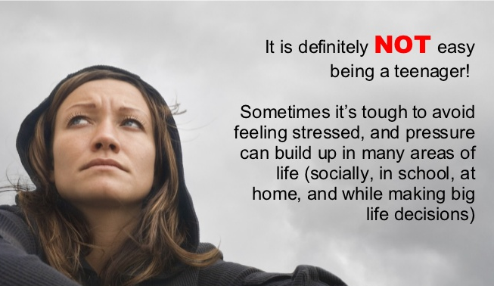
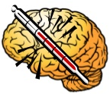

Slide 2
Final exam presentation
Subject: Oral Communication
Instructor: Ms. Madiha Munaf

Slide 3
Group members
Muhammad Ahsan
Muhammad Izhan
Sarah Ahmed Khan
Moazzam Ali
Asad Adnan
Syed Shakir Hussain

Slide 4
BEHAVIORAL CHANGES
Mental behavior at different ages

Slide 5
The topic
A persuasive
Analytical
informative

Slide 6
What is mental health?
It refers to maintenance of successful mental activity by
Maintaining productive daily activities
Maintaining fulfilling relationships
Maintaining the abilities to adapt to change and
To cope with stresses

Slide 7
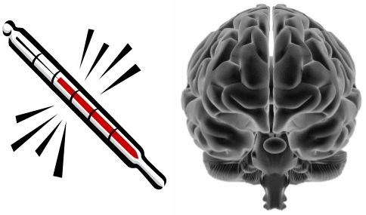
Mental illness can occur
When the brain or part of the brain is not working well or
Working in the wrong way

Slide 8
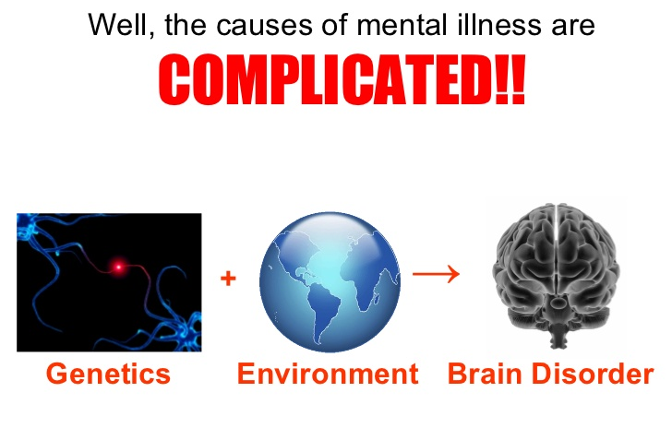
Causes ?

Slide 9
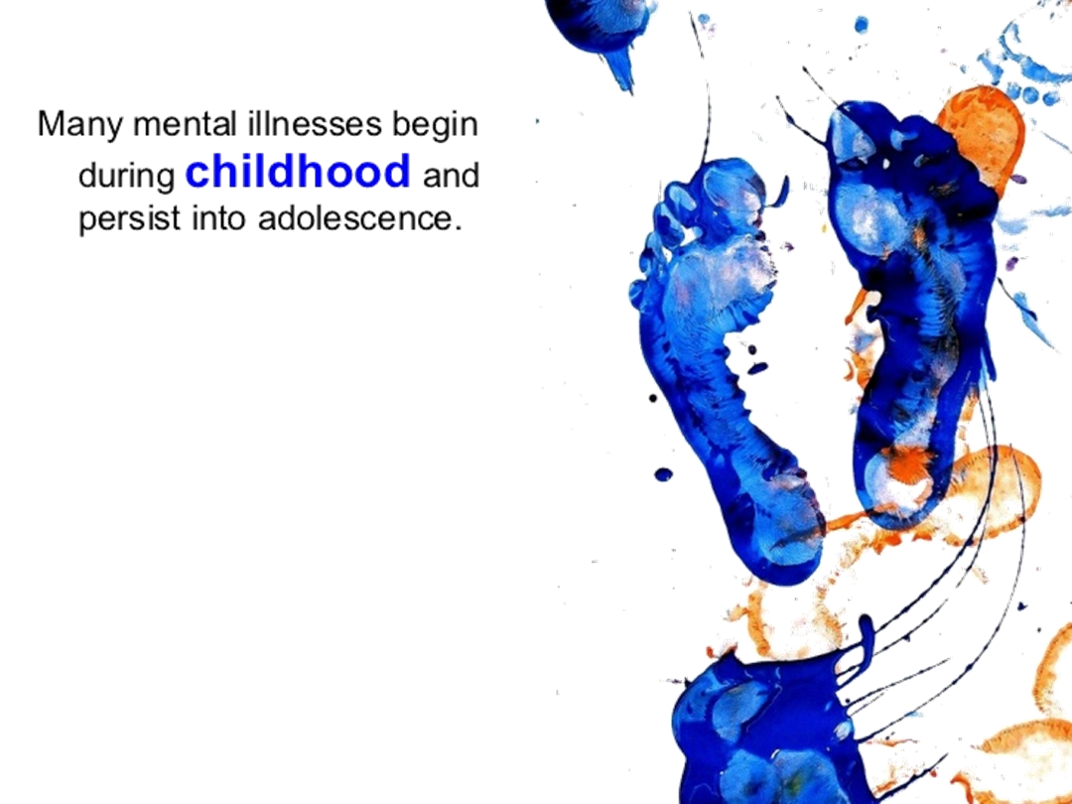

Slide 10
Reason for selecting this topic
The drastic change in the behavior of the teenagers over the last two decades
Disrespect for teachers
Disrespect of parents
Disrespect of other elders
Lack of patience

Slide 11
Target audience
Teenagers (15-26 years old)
Mental illnesses strike the adolescents in this most productive age
One out of four American is mentally ill
Mentally ill people not only devastate ill people but also their family and surrounding people

Slide 12
Exact purpose
To assure and remind that
These mental behavioral changes cause health issues
People with mental health problems are more likely to be victims of violence compared to others
Mental behavioral changes can effect relationships

Slide 13
Expectations
By the end of this presentation we expect you all to
Have a look back on your life style and find out all the causes of mental health problems and work them out the way we are going to discuss this ahead
BECAUSE

Slide 14
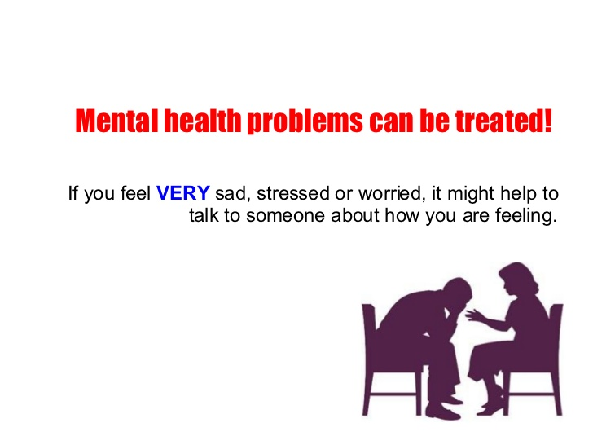

Slide 15
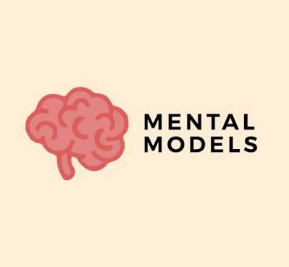

Slide 16
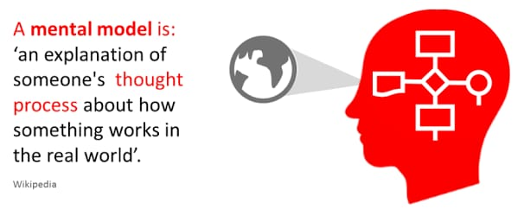

Slide 17
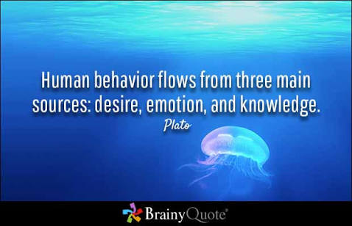

Slide 18
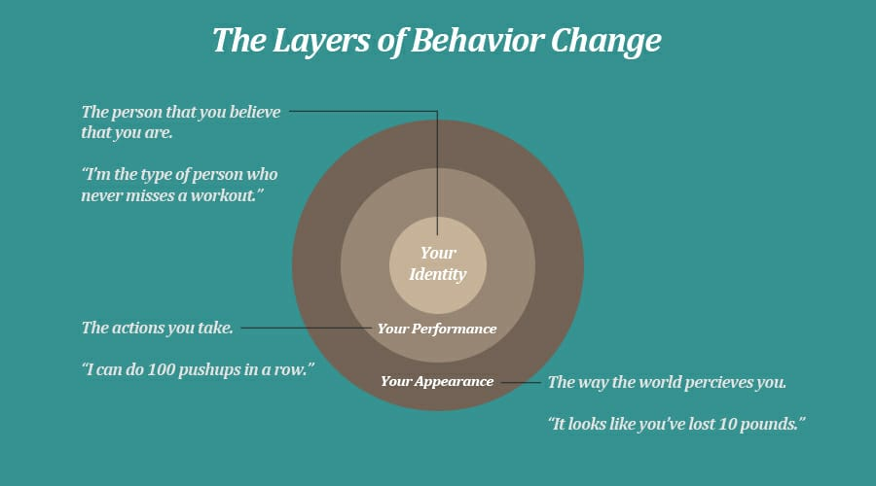

Slide 19
FACTORS EFFECTING HUMAN BEHAVIOR WITH FAMILY:
Increase Of Use Of Technology.
Family Gatherings.
Relationships.

Slide 20
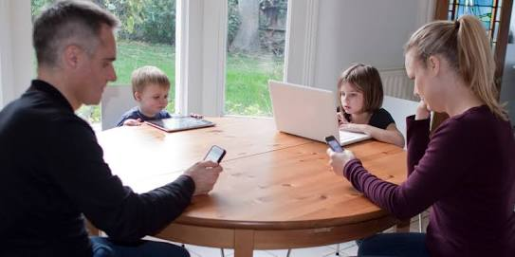
Is Technology Creating a Gap between Family:

Slide 21
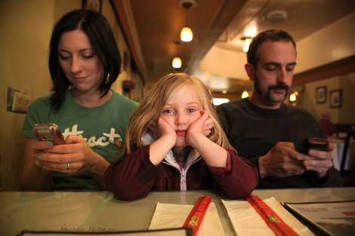

Slide 22
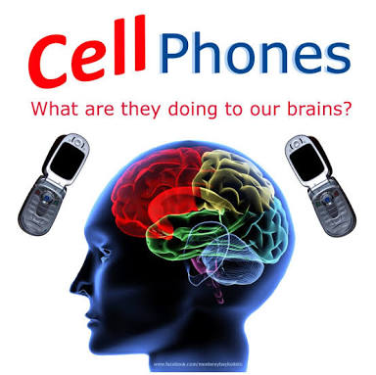

Slide 23
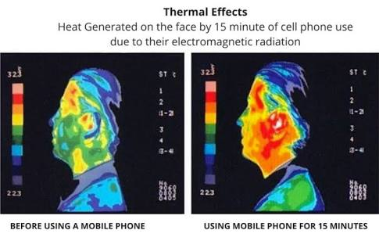
More recently, researchers who study the relationship of mobile phone use and mental health have also found that excessive or “maladaptive” use of our phones may be leading to greater incidences of depression and anxiety in users.

Slide 24
A Study In Computer in Human Behavior ,titled.
Anxiety and depression are related to problematic smartphone use.
Problematic smartphone causes symptoms.
Due to use of Mobile Phone our muscles get tiff and circulation of blood cannot properly connect to our brains and we feel lack of energy and many other symptoms.

Slide 25
STAGES OF LIFE

